Slide 1
Portuguese Bank - Marketing Campaign
Using machine learning to predict subscribers

Slide 2

Campaign Goals
Sell long-term deposit through telemarketing phone calls.
Bank agents execute phone calls to a list of clients to see if they are interested or not.
Binary answer - Yes or no

Slide 3
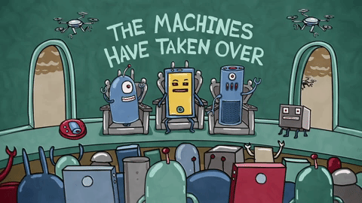
What is it going to be done?
Use the dataset from previous marketing campaign to see what type of people are more likely to subscribe to this campaign.
The project will be using visualization techniques to identify trends and correlation, and machine learning models for prediction.

Slide 4
Dataset - Variables
Total Variables - 21
20 Independent variables ranging from job category to interest rate level.
1 dependent variable - Subscribed (y/n)

Slide 5
EDA - Exploratory Data Analysis
Out of the 20 independent variables we identified 10 variables that have a meaningful impact in a client subscribing in the campaign.

Slide 6
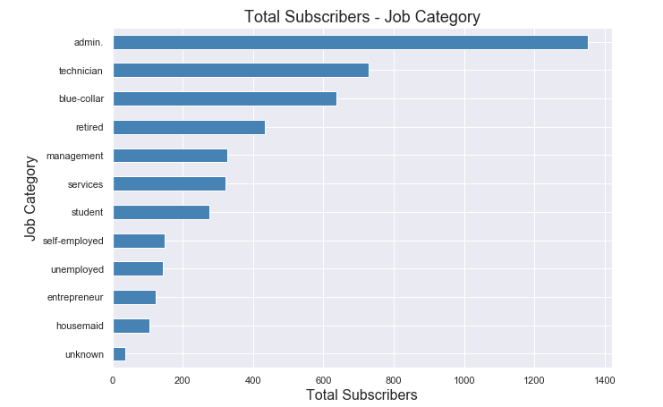
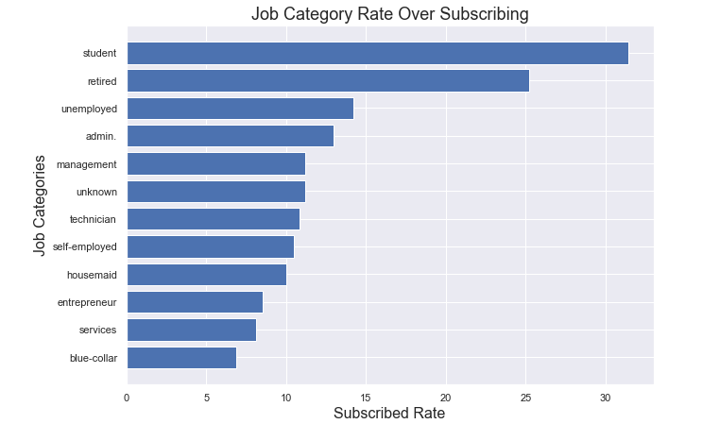
Job Category
Notes:
First graph - total subscribers by job category
Second graph - job category rate over subscribing.
Interesting observation - As we can see in the second graph, the top job categories are people that are currently not working, student, retired and unemployed.

Slide 7
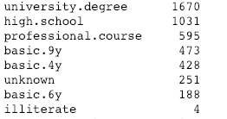
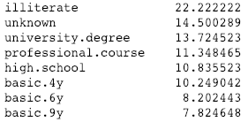
Level of education
Notes:
Most of of the people that have subscribed have a university degree.
Interesting was that the highest rate is from illiterate people, with 22% of illiterate subscribing. However, there were only 4 illiterate subscribers, making this probability of 22% not very accurate.

Slide 8
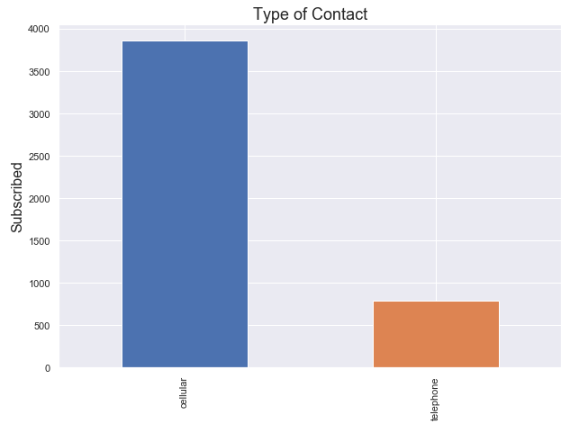

Type of contact
Notes:
83% of the subscribers were reached on their cell phones.
The rate of subscribers when reaching on their cell phone was 14.7%, while on the telephone only 5.2%

Slide 9
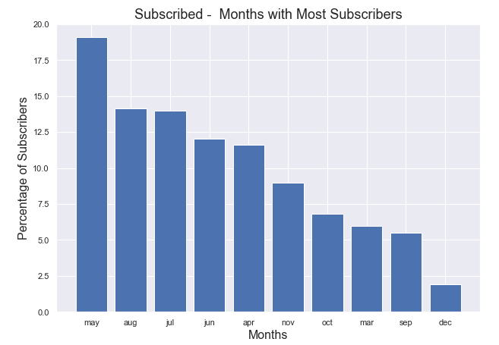
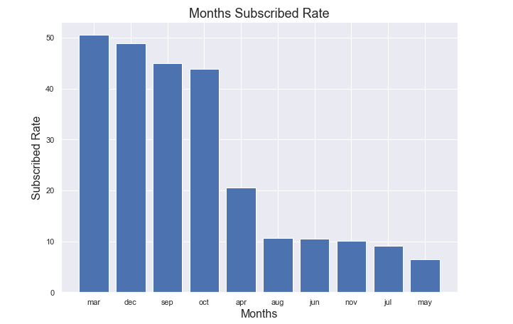
Month of the year
Notes:
Most of the subscribers were done during may, which is interesting as may was the month with lowest rate of subscriber over total contacts.

Slide 10
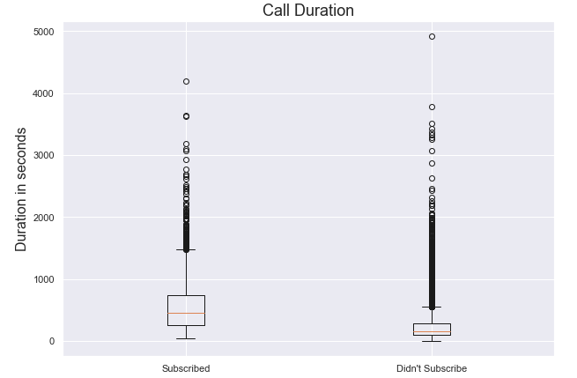

Call duration
Notes:
The calls that did not generate any subscribers took in average 220 seconds, while the calls that generate subscribers were in average 550 seconds. Longer calls, higher chance to subscribe.

Slide 11
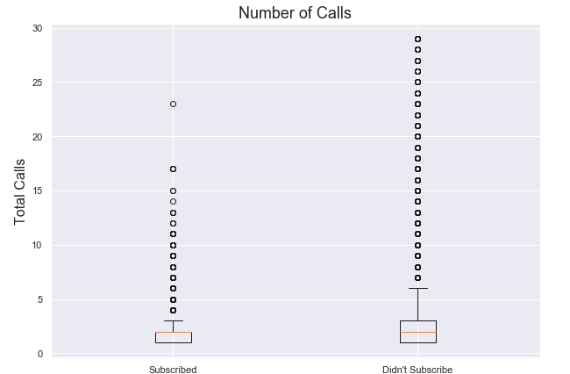
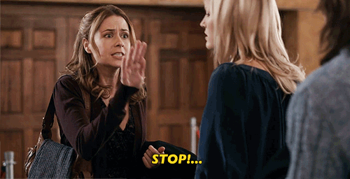
Notes:
Most of the people that subscribed, subscribed with less than 2 calls. After 2 calls, the chance of subscribing decreases a lot.

Slide 12
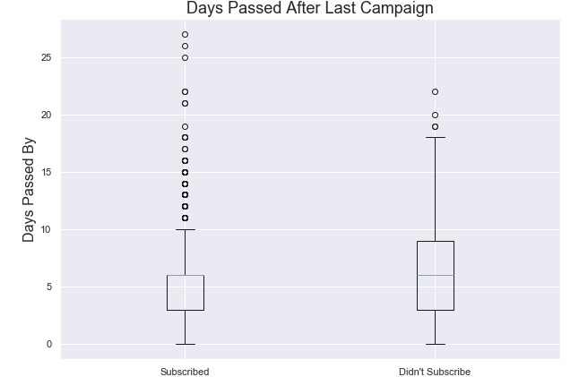
Number of days passed after last campaign
Notes:
Calls shouldn’t be right after, but agents cannot take too long to call them either. The best time to reach people is after 3 to 6 days from the last campaign.

Slide 13
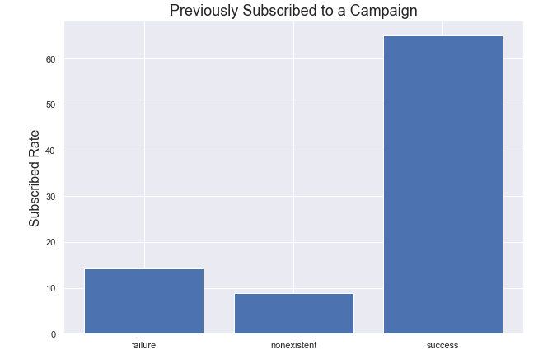
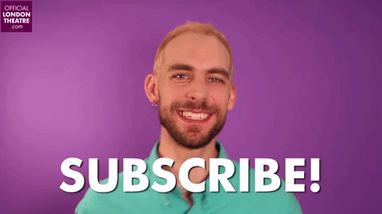
Previously Subscribed
Notes:
The graph above shows that 65% of the people that previously subscribed to a campaign, subscribed to this campaign. So, keep telling them to subscribe!

Slide 14
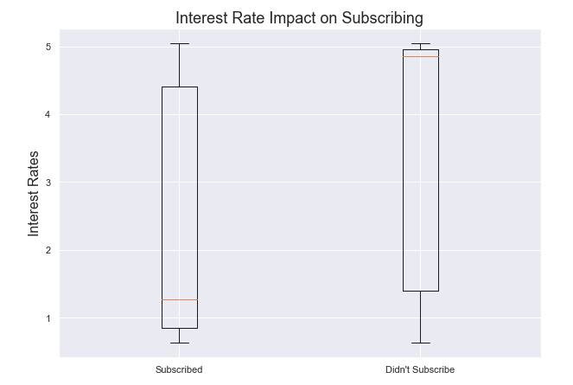
Interest Rate
Notes:
The graph above shows that most people subscribed when interest rate was low, median interest rate to subscribe was 1.26.

Slide 15
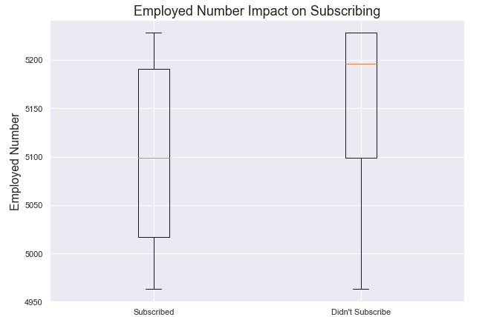
Employed number
Notes:
The graph above shows that the months with less people employed in the economy were also the best.

Slide 16
Machine Learning
We tested 3 different models to in our dataset, they are:
Logistic Regression
Gradient Boosting
Random Forest
Rather than accuracy score, we focused in three different metrics:
Non-subscriber precision rate (Accuracy when we predict someone is not going to subscribe)
Subscriber recall rate (Percentage of the total subscribers the model is able to identify)
AUC (How much are we giving up by correctly predicting the true positives)
Why?
We are looking for the model that can find the most number of subscribers, while having the least errors and high precision when identifying a non-subscriber

Slide 17
Logistic Regression
Non-subscriber precision rate - 98%
Subscriber recall rate - 89%
AUC - 93.6%

Slide 18
Gradient Boosting
Non-subscriber precision rate - 94%
Subscriber recall rate - 56%
AUC - 93%

Slide 19
Random Forest
Non-subscriber precision rate - 99%
Subscriber recall rate - 95%
AUC - 93.06%

Slide 20

The best model
For the purpose of this campaign, random forest was the best model.
The random forest is able to:
Identify a non-subscriber with 99% accuracy
Predict 95% of all the subscribers
93.06% AUC - True positive by false positives.

Slide 21

Nice! So, what does that mean?

Slide 22

This means...
Contact about 30% of the people to achieve the same results
Save 2068.5 hours for the sales department to be used elsewhere
Save € 28, 339
Time saved by average hourly salary in portugal
If the list has the same number of contacts
Make use of the high accuracy prediction of non-subscriber in our model to identify those who are not going to subscribe and create a more enticing campaign for them.

Slide 23

THE END

